Slide 1
INTRODUCTION TO SAP CLOUD PLATFORM

Slide 2
What is SAP Cloud Platform?
Platform as a service(PaaS)
Innovative cloud deployment and development platform
Build, extend and integrate business applications in the cloud.
Supported by multiple cloud infrastructure providers.

Slide 3
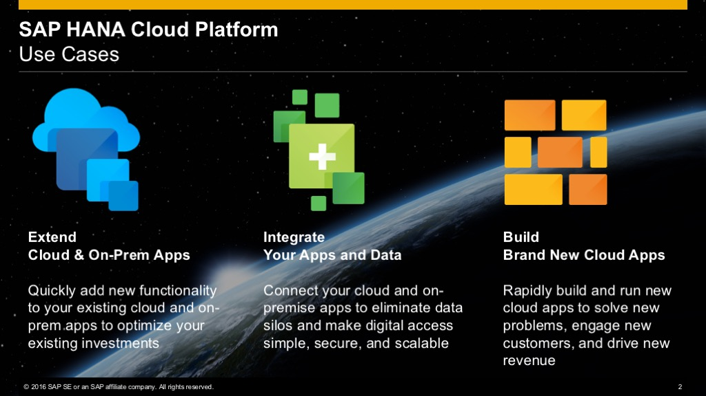
SAP Cloud Platform – Main use cases

Slide 4
Environments in SAP Cloud Platform
Cloud Foundry
Neo

Slide 5
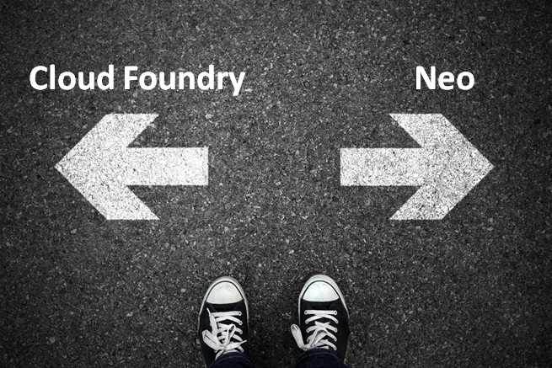
Which environment to use?

Slide 6
Cloud Foundry Environment
Open source platform maintained by Cloud Foundry environment.
Multiple run times like Java, Node.js.
We can bring in our own languages.
IoT, Machine learning scenarios and develop applications using SAP HANA extended application services advanced model.
Multiple data centers like GCP, Azure and AWS.
CF supports Business Application Studio

Slide 7
Neo Environment
Java, HTML5 and SAP HANA XS Applications.
It supports only SAP data center.
SAP Web IDE Full Stack.

Slide 8
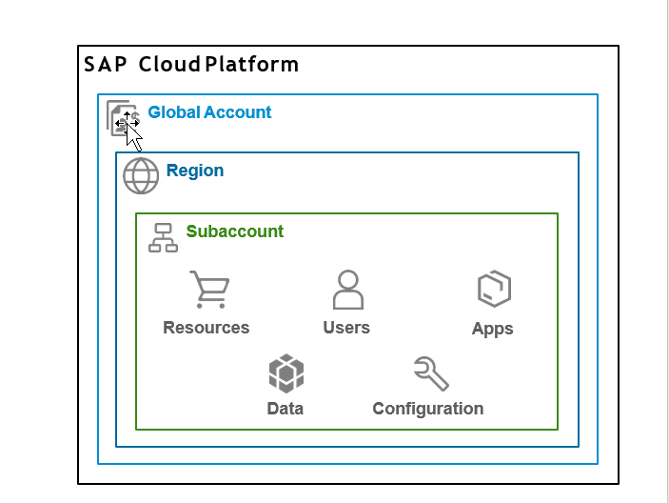
SAP Cloud Platform Accounts
Global accounts and sub accounts in SAP Cloud Platform are the way in which all of your activities in SAP Cloud Platform are structured.

Slide 9
Global Account
Realization of contract made with SAP.
Region and environment independent.
Two type of Global Accounts
Enterprise Account (paid)
Trial Account (free)
All metrics, billing, quota and resources done for a Global Account.

Slide 10
Subaccount
A Global Account can host multiple Sub Accounts.
Subaccounts in a Global Account are independent of each other.
Each subaccount is associated with a region and independent of our own location.
Spaces can be configured inside a subaccount for different business needs, or development teams according to the use cases.
The entitlements and quotas that have been purchased for a Global account have to be assigned to the individual sub accounts.

Slide 11
Regions
Represents a geographical location where applications, data and services are hosted.
A region is associated with one data center.
Provided by SAP or by Infrastructure-as-a-Service(IaaS) partners like Amazon Web Services (AWS), Microsoft Azure, Alibaba Cloud and Google Cloud Platform (GCP).
Region is chosen at the subaccount level.
For each subaccount we choose exactly one region and one environment.
For each region there is a different API Endpoint.
api.cf.us20.hana.ondemand.com – US West
api.cf.eu10.hana.ondemand.com – Europe (Frankfurt)

Slide 12
Trial Accounts
Free of charge with limited services and functionality.
One trial account per user.
Expires after 30 days, but can be extended to a limit of 90 days.
No service – level agreement with regard to availability of the platform.
Applications stop automatically after a certain period of time.

Slide 13
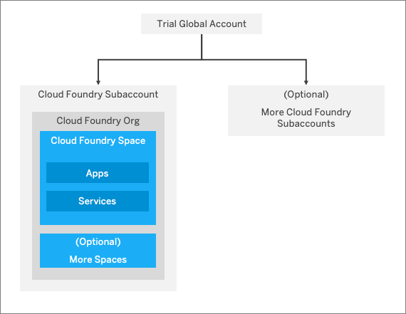
Trial Account Structure

Slide 14
SAP Cloud Platform cockpit
SAP Cloud Platform cockpit is the consolidated destination for operational needs.
Entry point to SAP Cloud Platform on the web.
Monitoring of resources, databases and applications.
Entire administration can be done from SAP Cloud Platform cockpit.

Slide 15
Navigation in the cockpit
There are 2 ways of navigating inside the cockpit
Using the left-hand side navigation
Using the path at the top of the page.
There are certain actions you can perform at each hierarchical level (global account, sub accounts, spaces etc.) called scope.
Inside the global account we can add members, create more subaccounts, add entitlements and quotas to subaccounts. These actions come under the global account scope

Slide 16
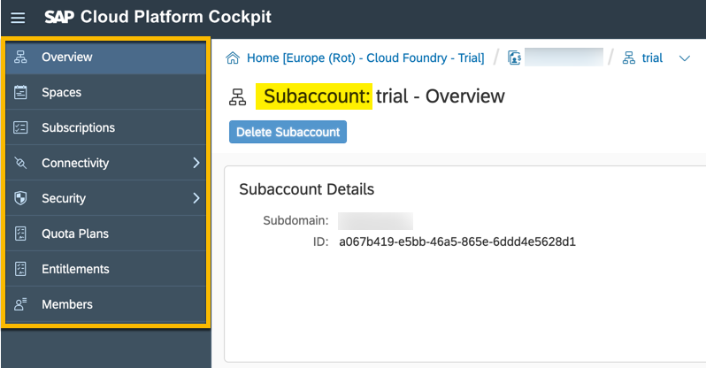
Left hand–side navigation
Cloud Foundry Subaccount scope:

Slide 17
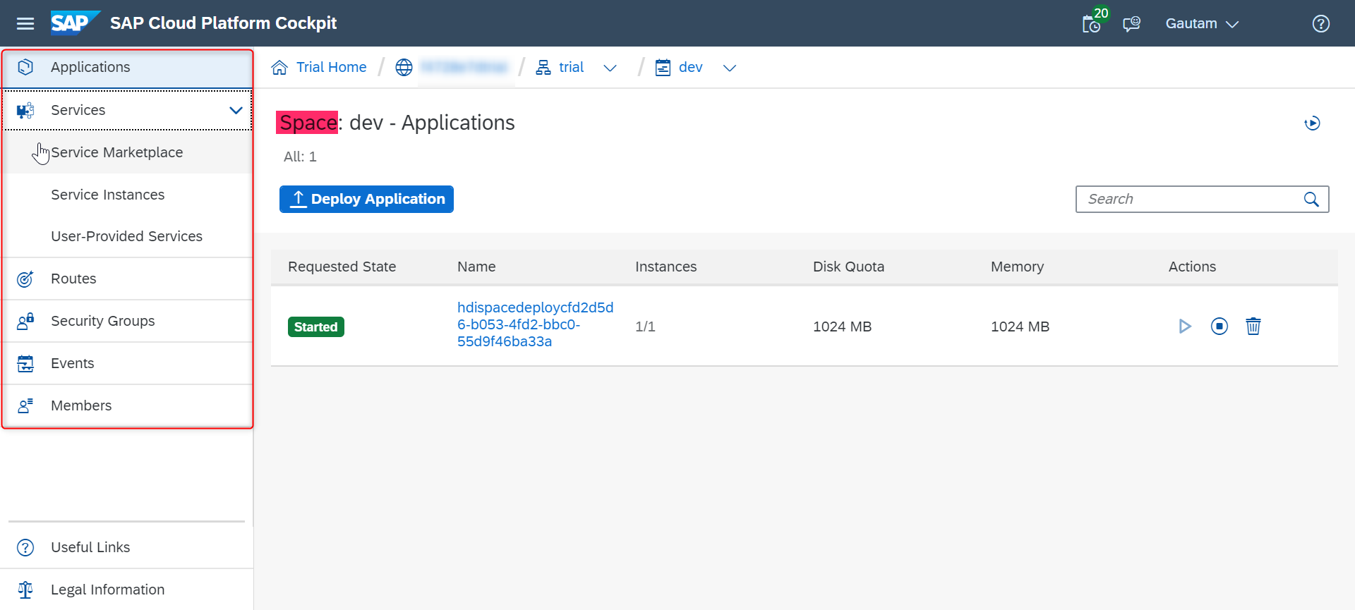
Cloud Foundry Space Scope:

Slide 18
Path
You can navigate back using the breadcrumbs at the top.
Coincide with the hierarchical path you have travelled in order to reach your current scope in the cockpit.
The last item in the breadcrumbs always represents the scope you find yourself in at the moment
To go back follow the breadcrumbs to retrace your steps.

Slide 19
Trial Home : - trial homepage
Global account – All your subaccounts and entitlements.
Represents your subaccount
Represents your space.
Your application running inside the space. Your current scope.

Slide 20
Services in the Cloud Foundry Environment
Create service instances and bind them to applications within that space.
A single instantiation of service running on SAP Cloud Platform.
Created using a specific service plan.
A service plan is a configuration variant of a service.
To integrate services with applications, the service credentials must be delivered to the application.
Bind service instances to your application to automatically deliver these credentials.

Slide 21
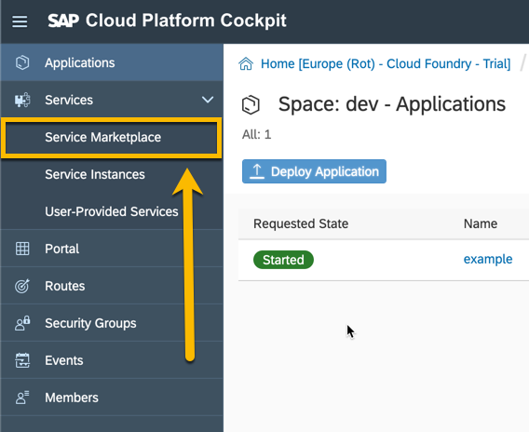
To create a service instance
Navigate to your space in the Cloud Foundry environment where you want to create the instance and choose Service Marketplace from the left hand-side navigation.

Slide 22
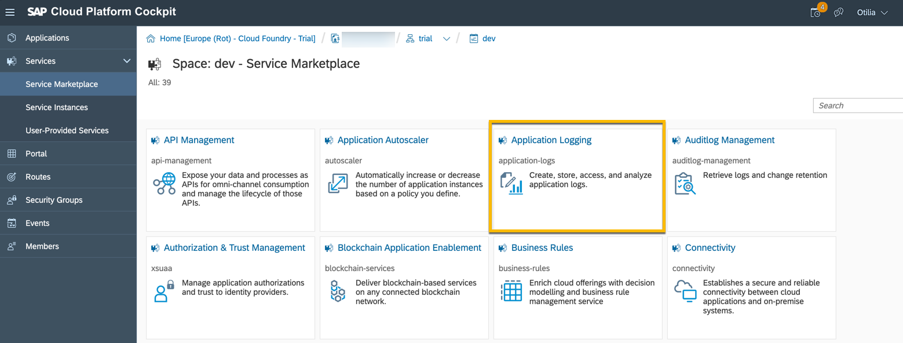
2. Choose the service for which you want to create an instance (let’s choose Application Logging as an example).

Slide 23
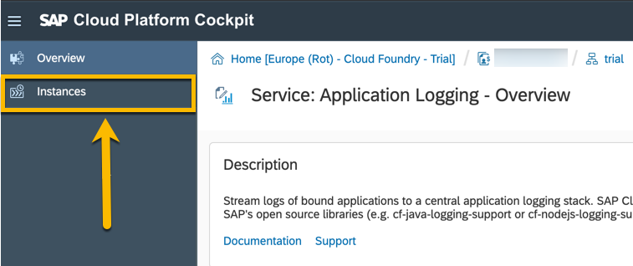
3. In the left hand side navigation choose instances.

Slide 24
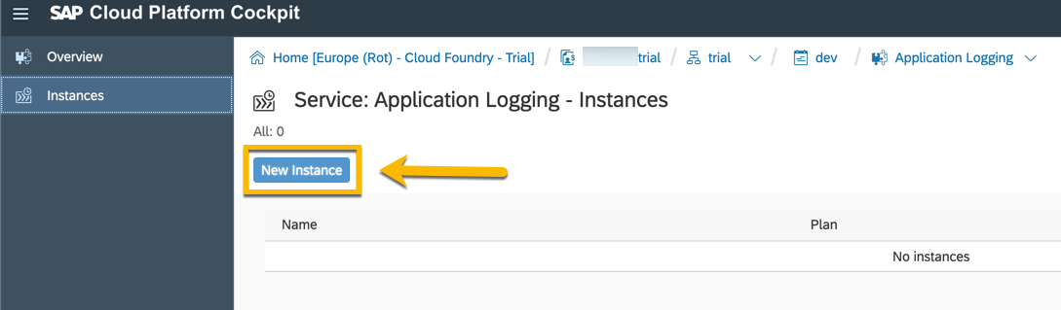
4. Click on the new instance button

Slide 25
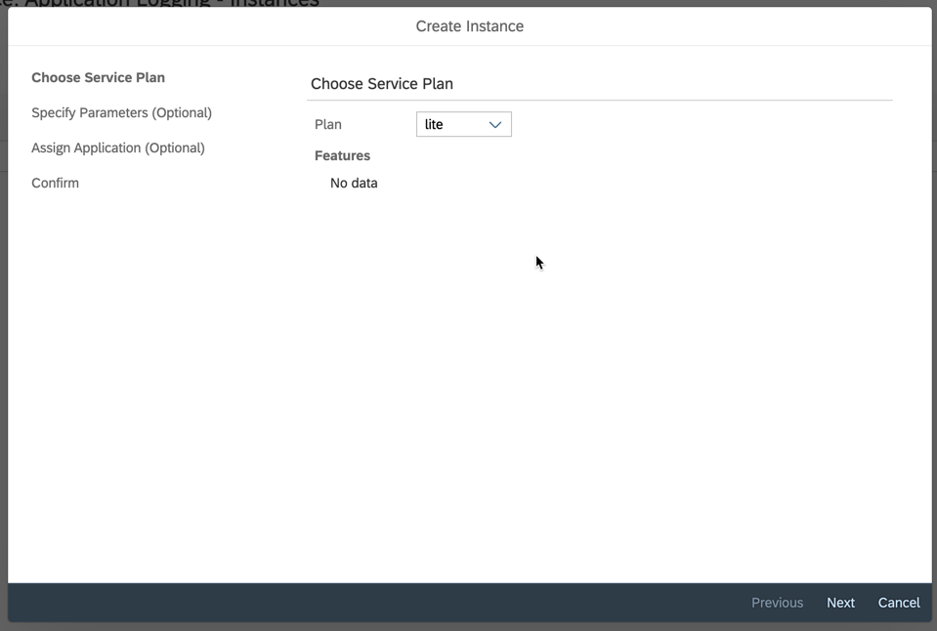
Follow the wizard to finalize the creation of the instance. This includes choosing a service plan and optionally adding parameters and an application to bind the instance to.

Slide 26
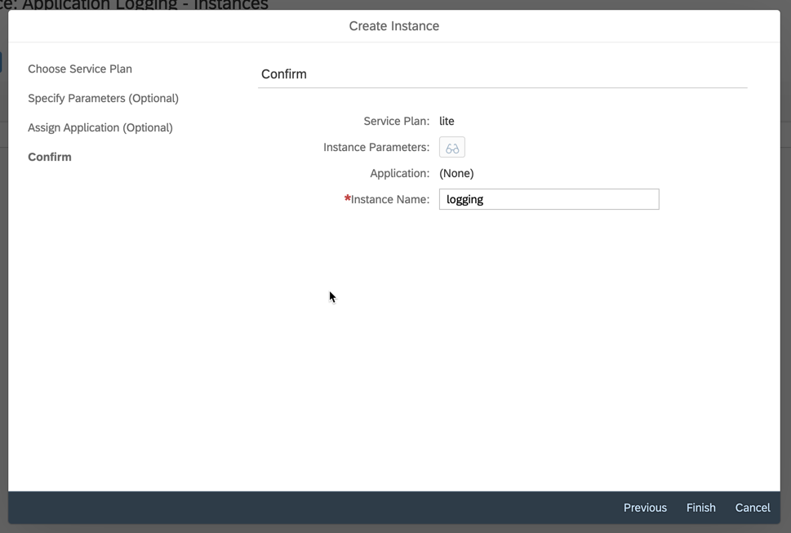
Finally enter a name for your instance and choose finish

Slide 27
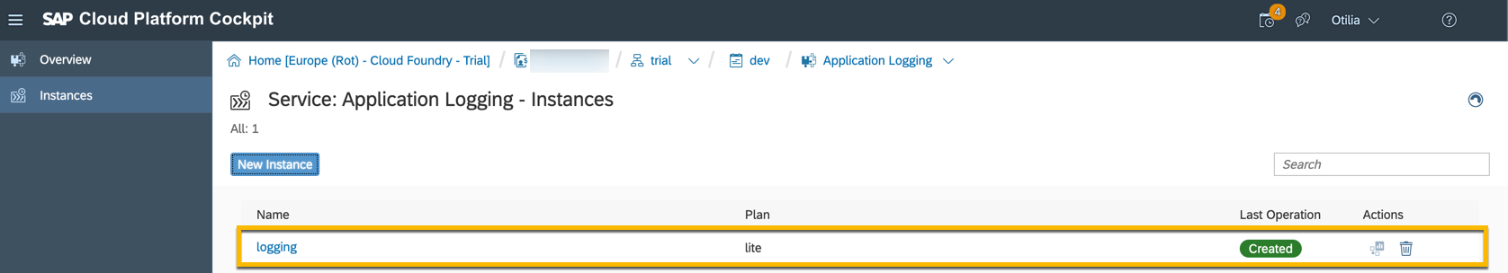
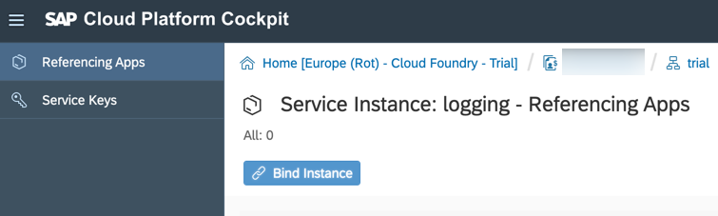
Your new instance will appear as shown below.
You can then click on it to bind it to an application if not done already.

Slide 28
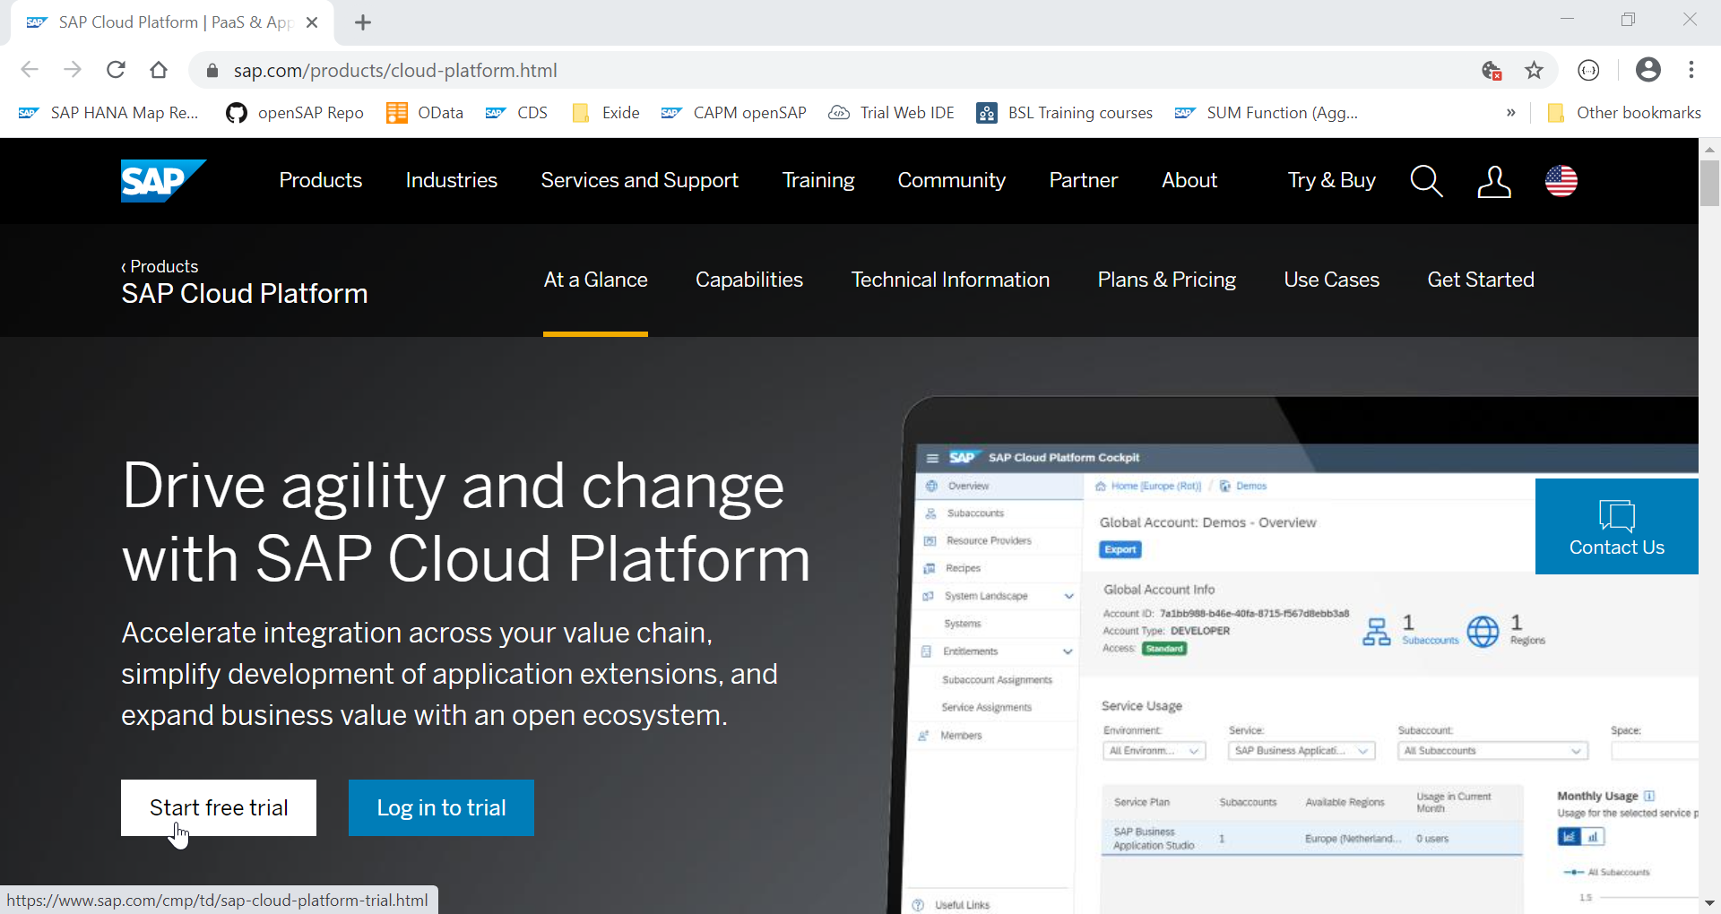
CREATING A FREE TRIAL ACCOUNT

Slide 29
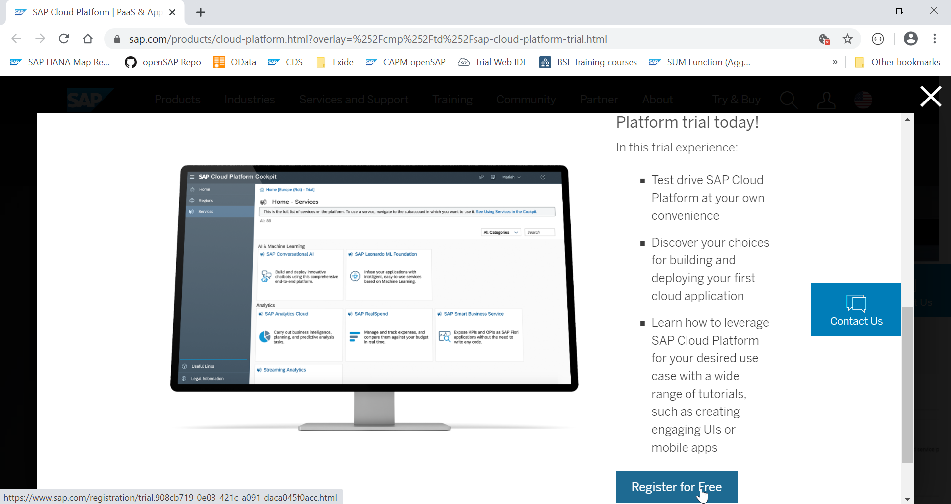

Slide 30
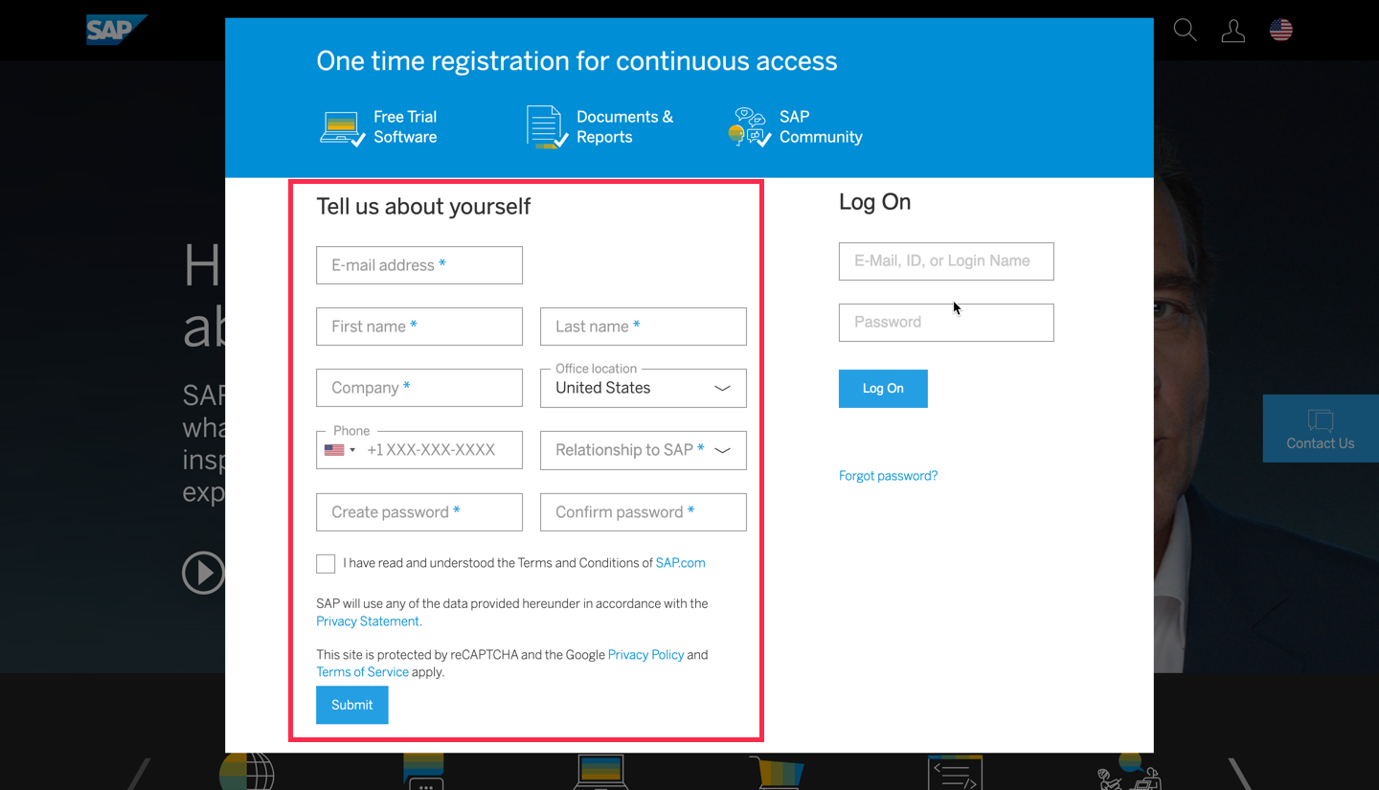
If you don’t have an account already, fill in the details on left-hand side of the dialog and click submit

Slide 31
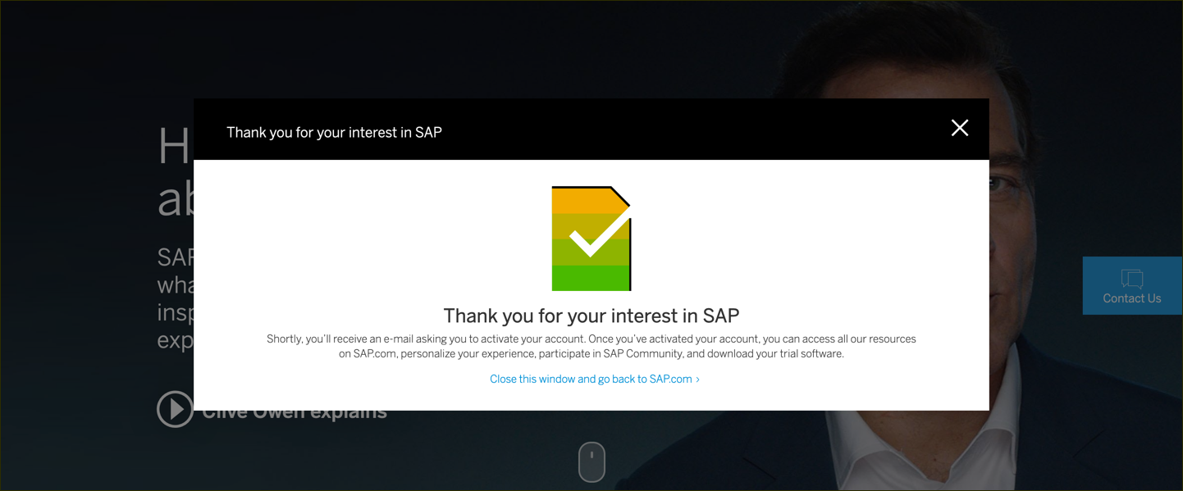
You will get an email saying activation link has been sent to you.

Slide 32
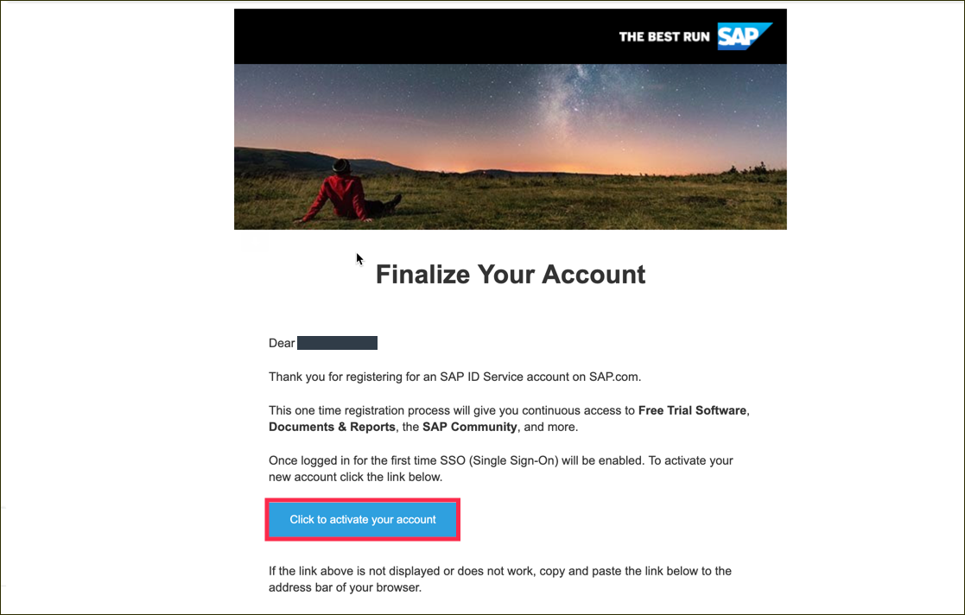
Click to activate your account

Slide 33
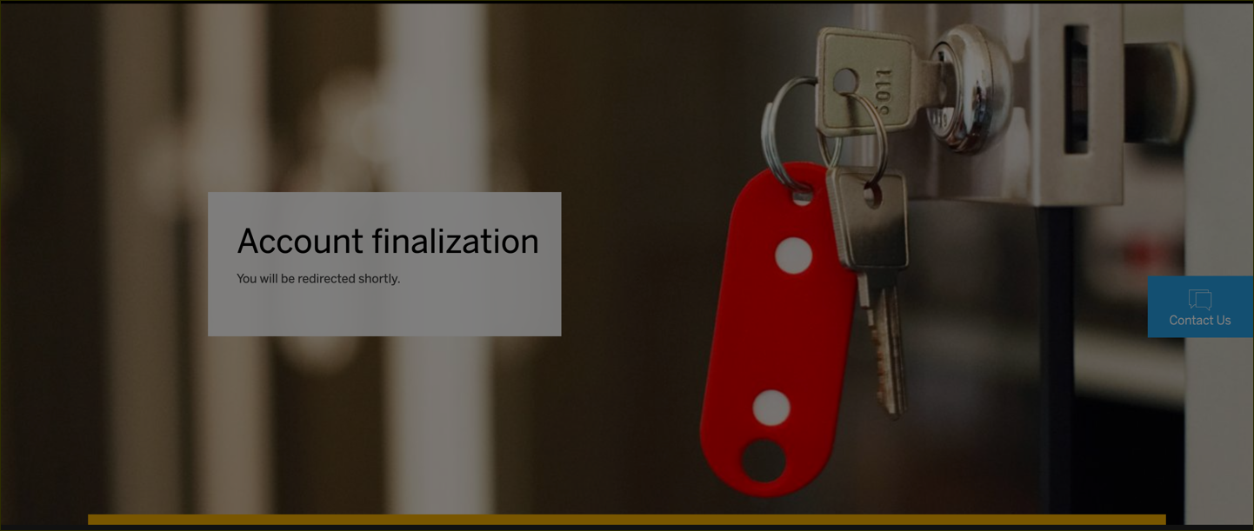
After activating your account you will see the following screen.

Slide 34
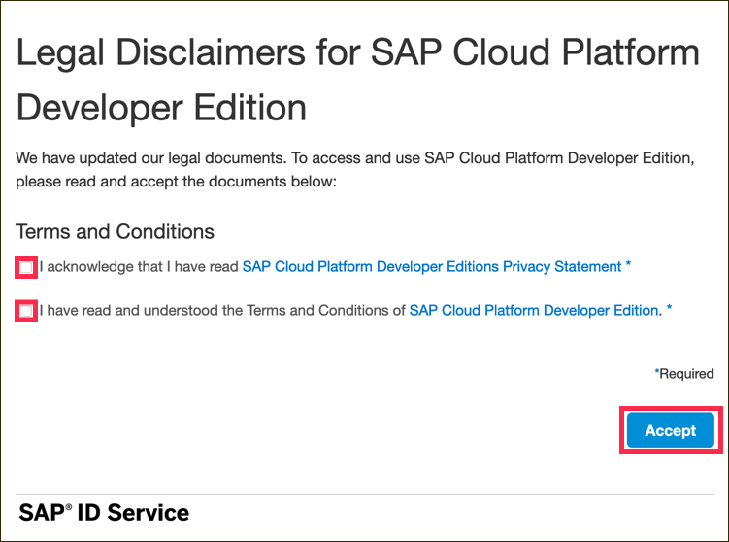
Go to SAP Cloud Platform page and click on Log on

Slide 35
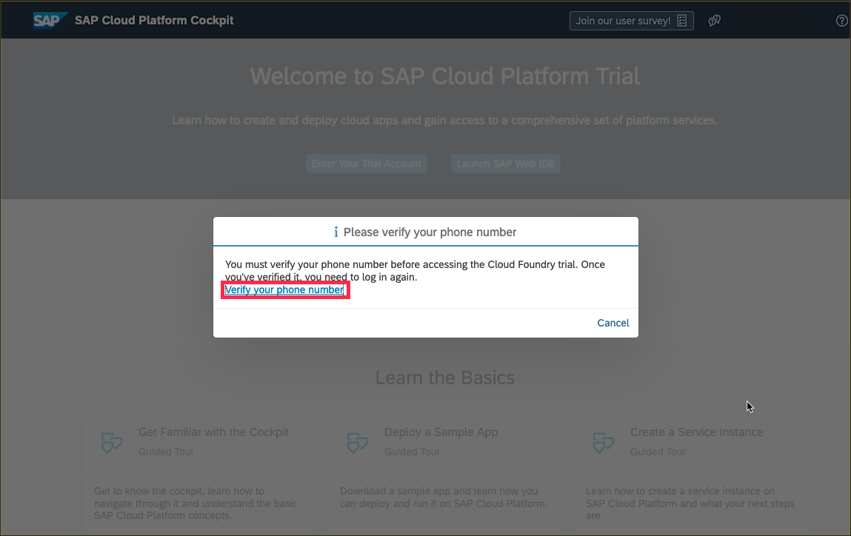
Verify your account with a phone number.

Slide 36
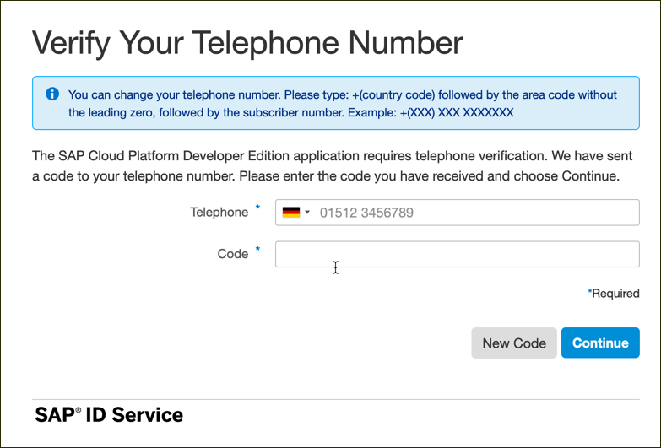
Enter your phone number and click New Code to retrieve a code

Slide 37
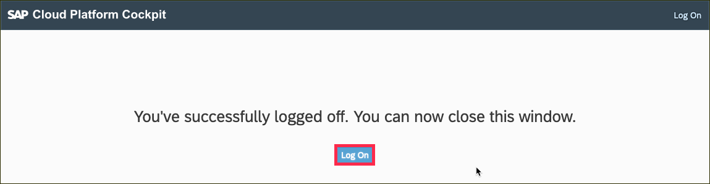
Click on Log on to log on to your verified account.

Slide 38
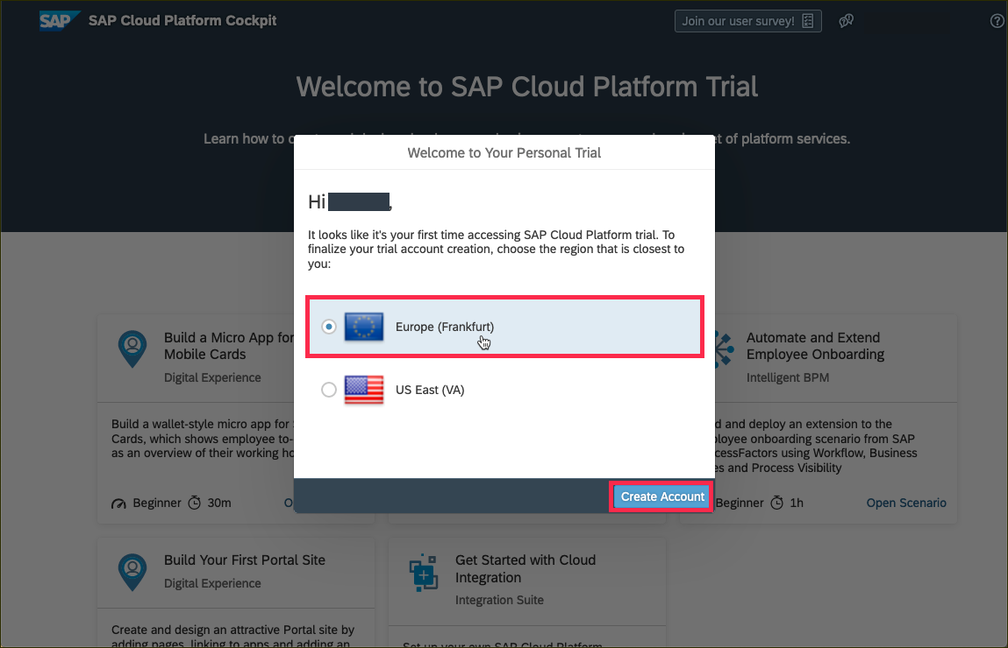
Create a subaccount which lives in a geographic region. Choose one of regions from this list.

Slide 39
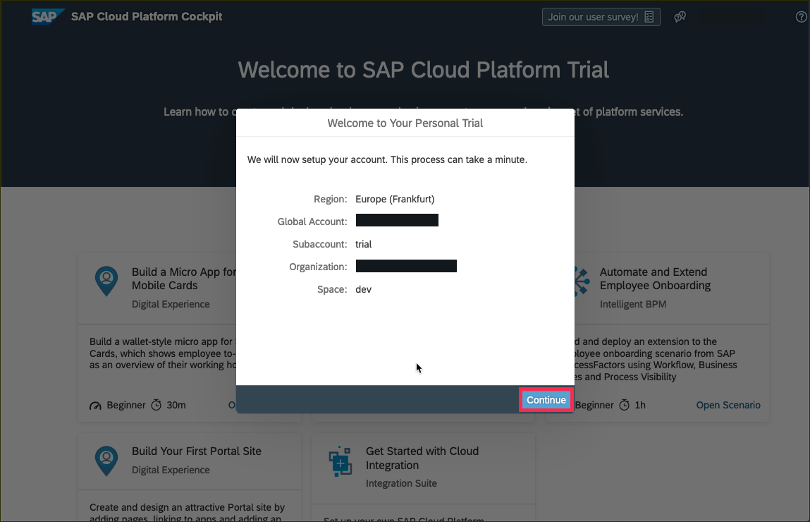
You will then see a dialog box while the account is set up. When complete, the dialog box will look like this. Click Continue to close to popup.

Slide 40
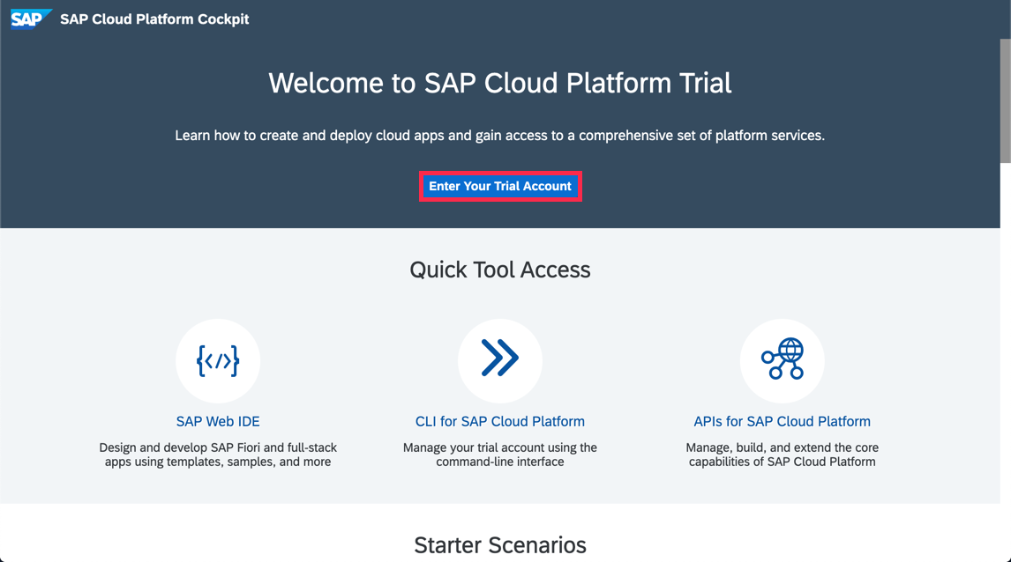
Click on Enter Your Trial Account to see your global account.

Slide 41
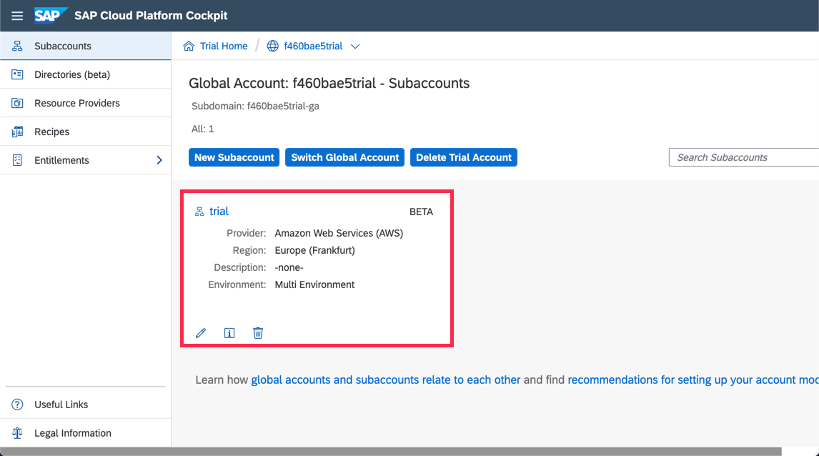
The global trial account contains one subaccount and space. Navigate to subaccount by clicking on the tile named trial (this name may vary if you created the subaccount manually).

Slide 42
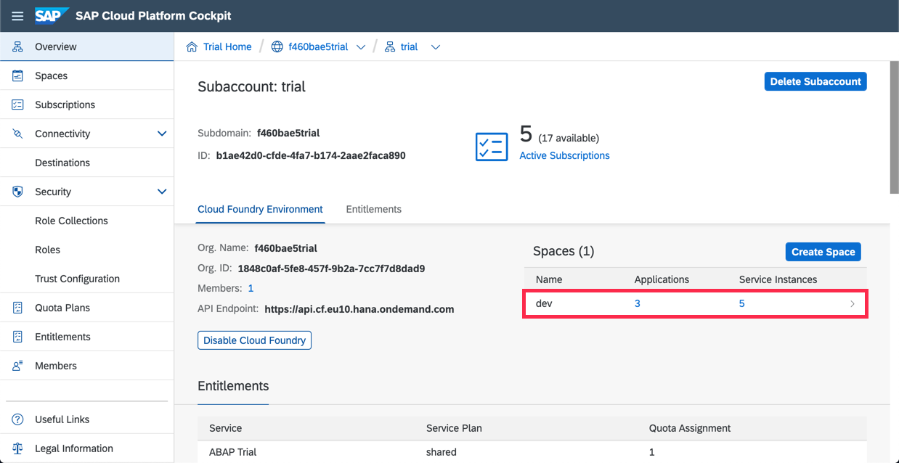
To get to the space, in which your applications and services live, click on the dev space.

Slide 43
Introducing SAP Web IDE
SAP Web IDE is web – based integrated development tool that simplifies end-to-end development of business applications.
tooling, prototyping, developing and deploying the application and make it available to end users.
Build SAP Fiori, mobile and Internet of Things (IoT) applications, even supports scenarios such as SAP S/4 HANA extensions.

Slide 44
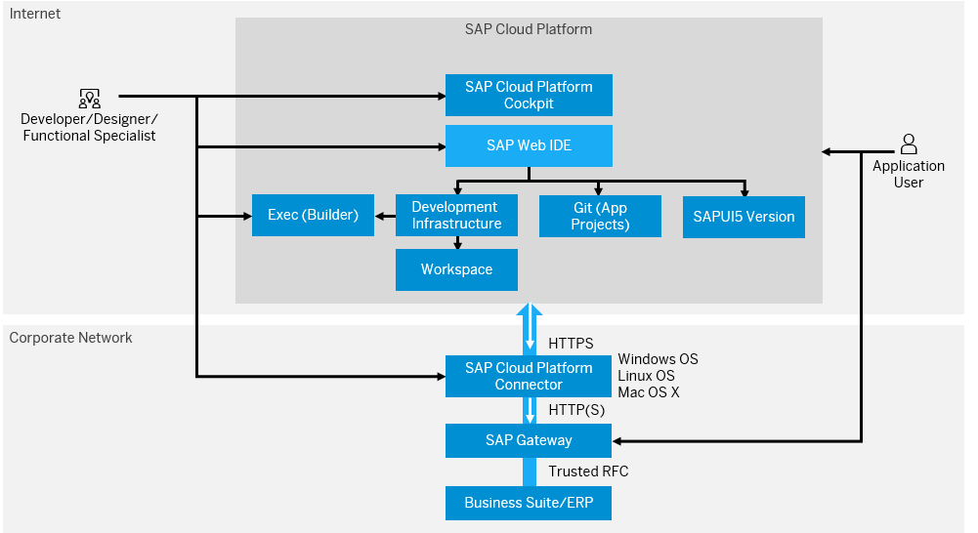
Architecture of SAP Web IDE

Slide 45
Component | Description
SAP Cloud Platform | PaaS to build, extend and integrate business applications in the cloud.
SAP Cloud Platform Cockpit | Central point of access in SAP Cloud Platform to manage all applications, resources, privileges, roles and users.
SAP Web IDE | Integrated development environment to build full stack business applications
SAP UI5 | SAP’s own User Interface technology
Git | Distributed Version Control System for source code management.
SAP Cloud Platform Connector | To connect on-premise SAP systems to SAP Cloud Platform with minimal configurations.

Slide 46
SAP Web IDE – features and benefits
SIMPLE - no cost, no complex infrastructure, reduced effort.
INTEGRATED – extend and integrate services to create intelligent business applications.
PRODUCTIVE – focus only on domain logic and kick start development.

Slide 47
Additional Features
Zero installation and maintenance
Java and Node.js Debuggers.
Business Application Development.
SAP HANA database graphical editors.
Source code editor with code completion, validation and formatting.
Integrated Git source control.

Slide 48
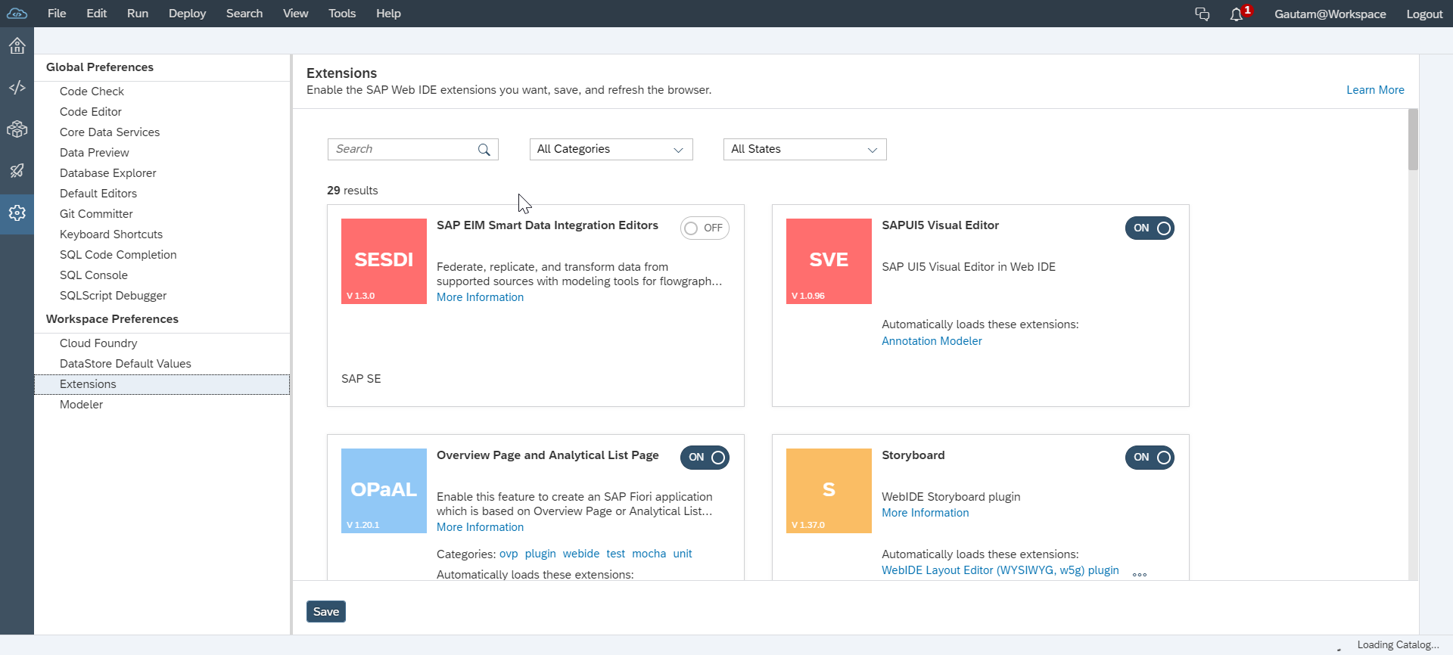
Extensions
To enable Preferences
Tools > Preferences > Workspace Preferences > Extensions
For example,
SAP HANA Database Development Tools extension needs to enabled to create design time database artifacts, such as data models, views or procedures.

Slide 49
Accessing SAP Web IDE
Go to SAP Cloud Platform Cockpit Home page
Click on SAP Web IDE
Bookmark the URL
Configure API Endpoint in Cloud Foundry settings in SAP Web IDE.

Slide 50
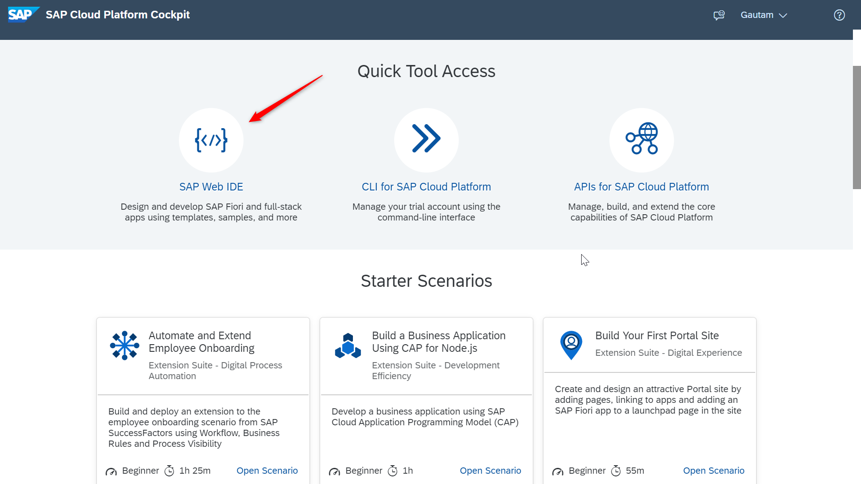
Go to SAP Cloud Platform Cockpit home page.

Slide 51
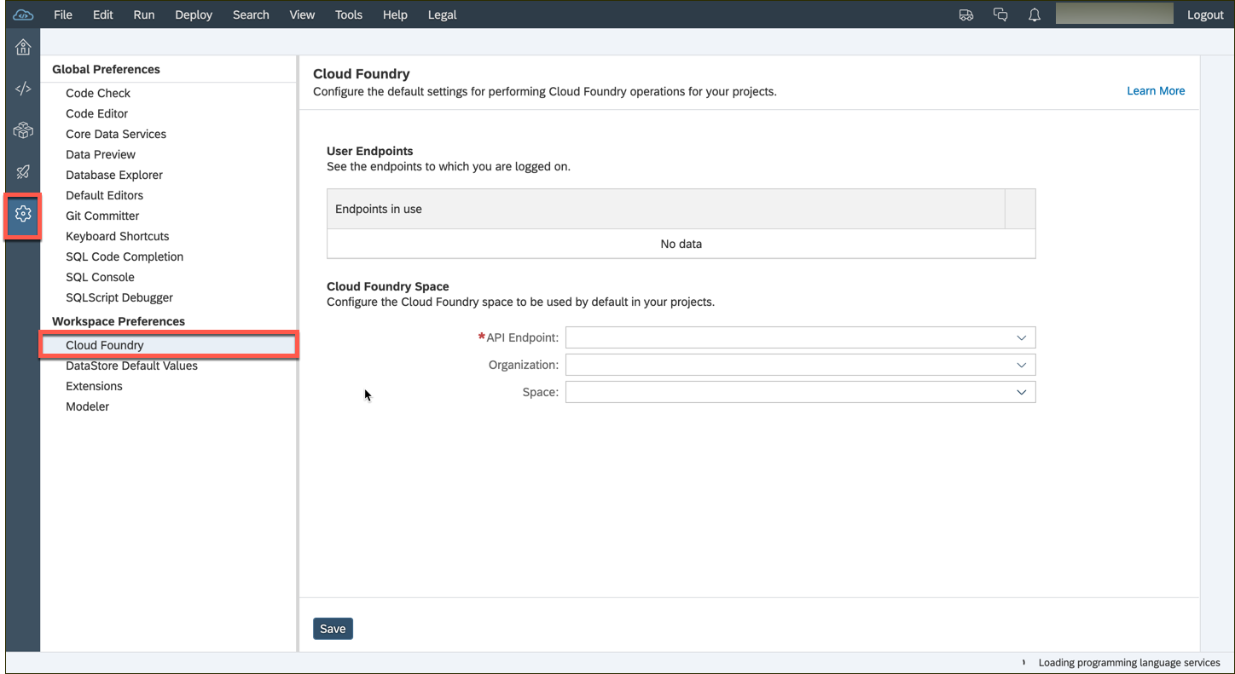
Go to Preferences > Workspace Preferences > Cloud Foundry

Slide 52
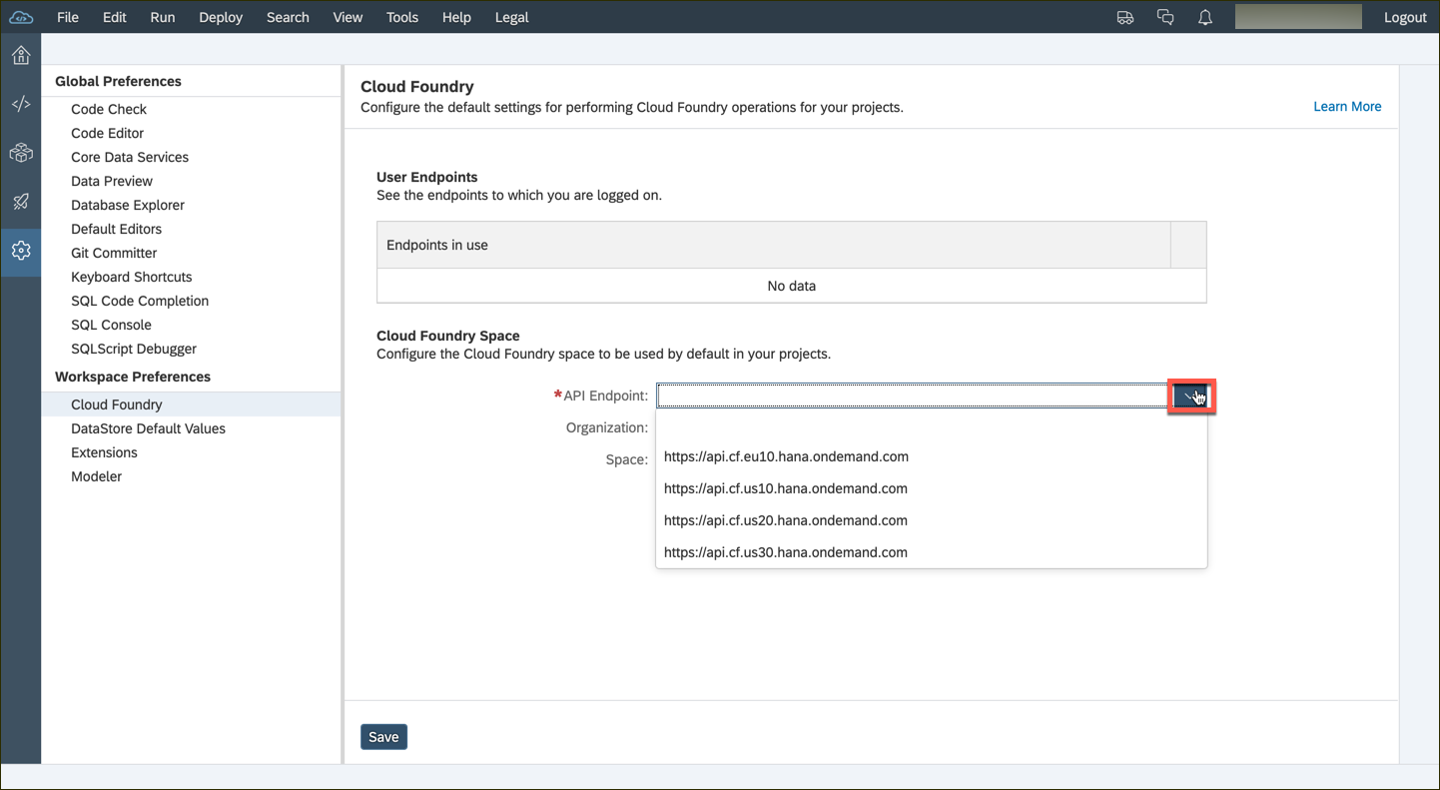
Configure the API Endpoint depending on the data center of your subaccount.

Slide 53
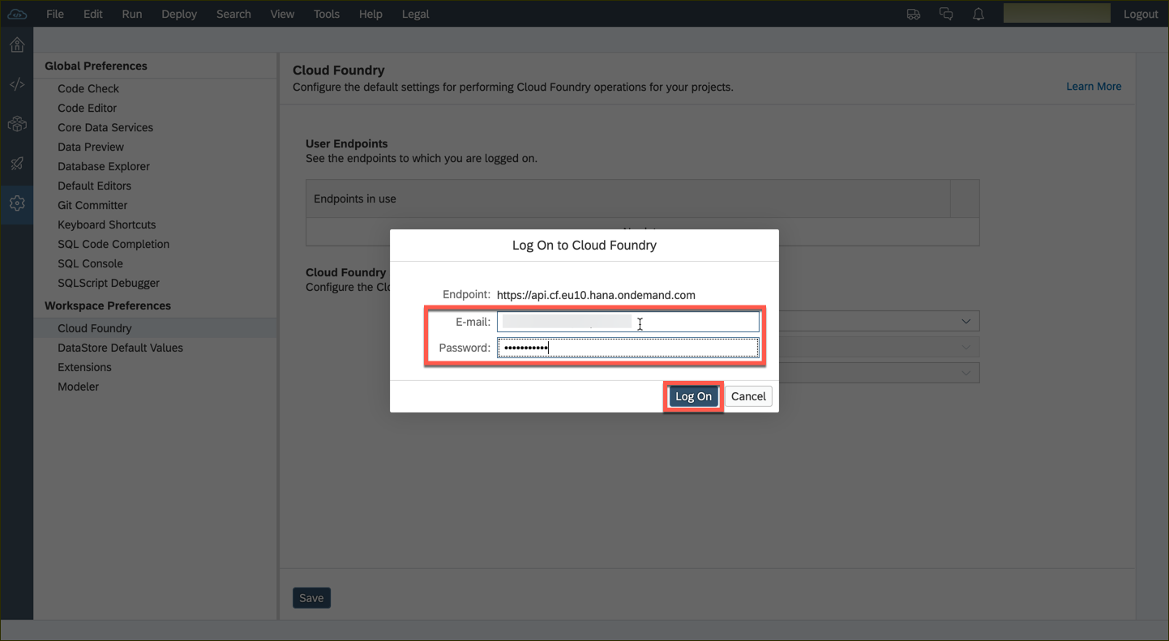
You might be prompted for your Cloud Foundry credentials. Enter the credentials you used for SAP Cloud Platform Cockpit.

Slide 54
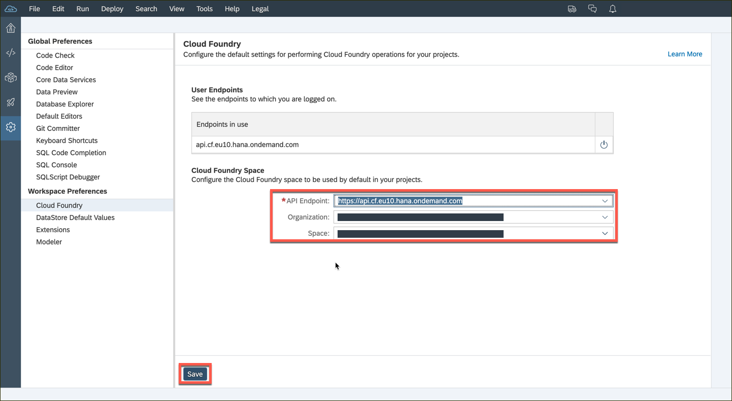
If there is a subaccount in the selected data center then the organization and space fields will be populated by default. You can change these values via the dropdown list. Hit the Save button thereafter.

Slide 55
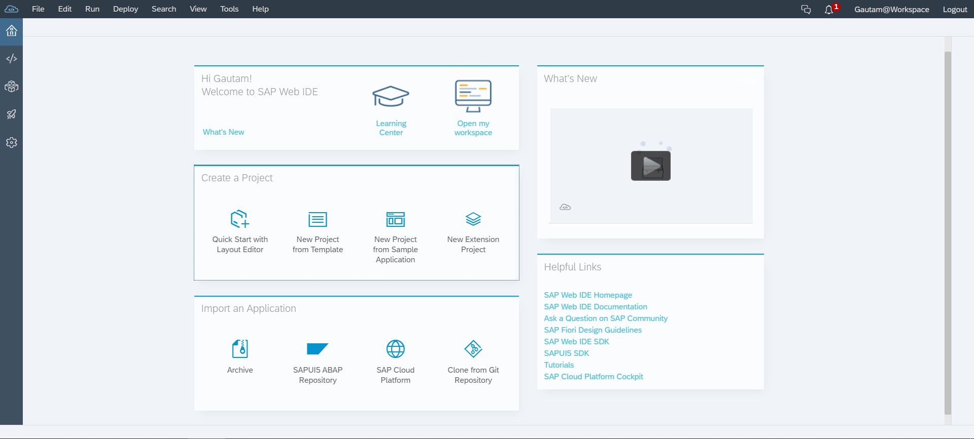
Home Screen of SAP Web IDE
Perspectives:
Home(Welcome)
Development
Database Explorer
Storyboard
Preferences
Quick and easy access to most common creation actions.
Link to external resources and tools

Slide 56
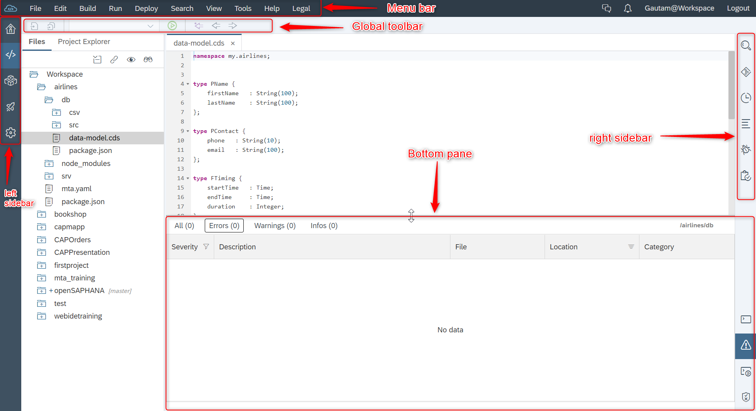
Navigating SAP Web IDE

Slide 57
SAP Business Application Studio
Tailored for efficient development of business applications for the Intelligent Enterprise.
Evolution of SAP Web IDE, the current development environment.
It is available as a service in SAP’s Cloud Foundry Environment.
Provides solution based on development spaces.

